Slide 1


Attention Is All You Need:Transformer
Junhee Cho
Network Science Lab
The Catholic University of Korea
E-mail : junhe0733@gmail.com

Slide 2
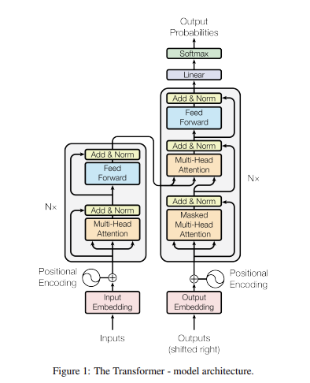
Architecture

Slide 3
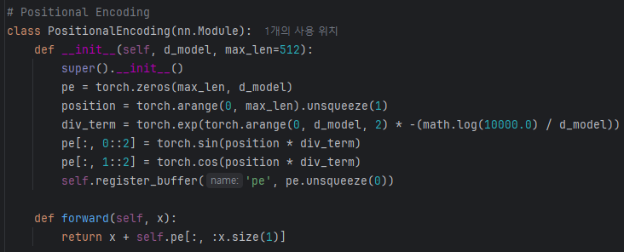
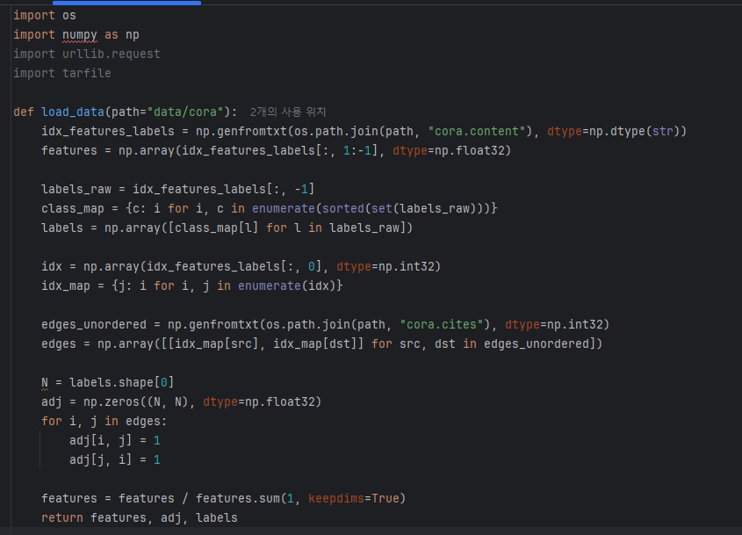

Code
Positional Encoding

Slide 4
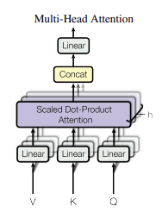
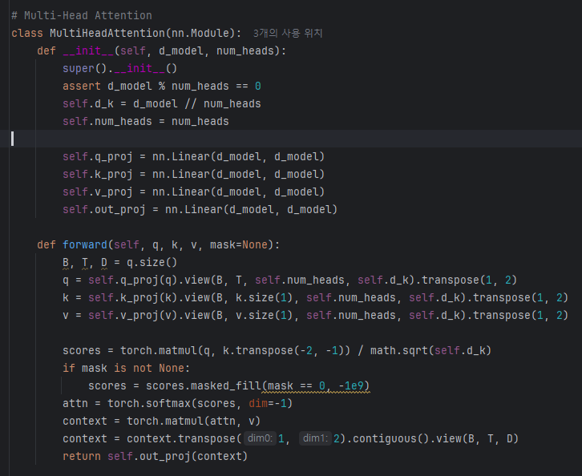


Code
Multi-Head Attention

Slide 5
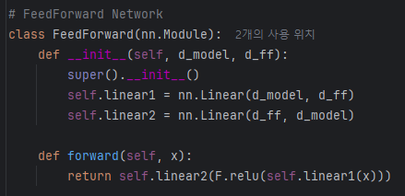

Code
FeedForward Network

Slide 6
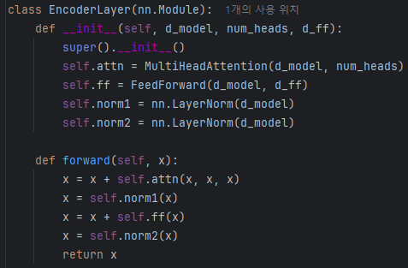


Code
Encoder Block

Slide 7
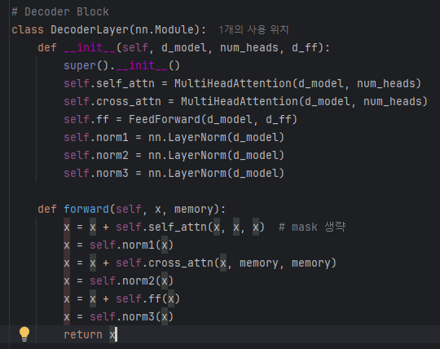

Code
Decoder Block

Slide 8
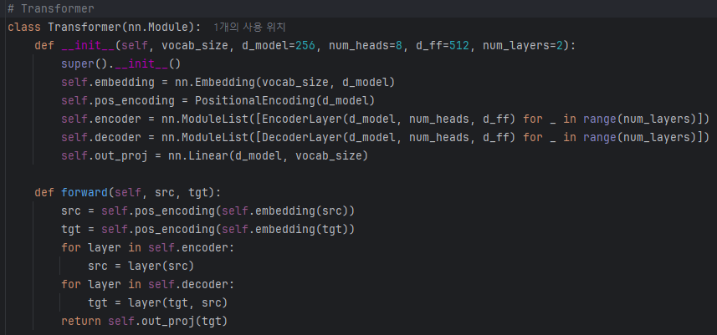

Experiment
Transformer

Slide 9
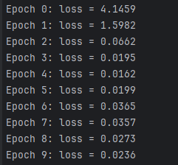
Experiment
output

